Slide 1

Bangla news image caption generation
GitHub Repositorie

Slide 2




Team ELON (A1-G4)
Md.Rufiad Rahi Arnob
Safi Ullah Chowdhury
Md. Nazmul Islam Nayem
Niaz Mahmud
20101006
https://github.com/Md-rufiad-rahi-arnob
20101010
https://github.com/SafiChowdhury
20101013
https://github.com/Nazmul246
20101019
https://github.com/mahmud-niaz

Slide 3

Problem Definition
Most of the caption generation tasks exist in the English language and no work has been reported yet in Bangla for news caption to the best of our knowledge.
A quality image captioning system requires an annotated training corpus. However, there is no such standard dataset available for this resource-constrained language.

Slide 4

Objective
Images are a beautiful way to communicate and understand our surroundings. A good image can express things more loudly than a thousand words.
The proposed news caption generation system has been developed to understand the visual scenes of the newspaper.
We aim to develop a news image caption generation model in low resource Bangla language. Our model is well suited as a baseline for future work on the Bangla news image caption generation.

Slide 5
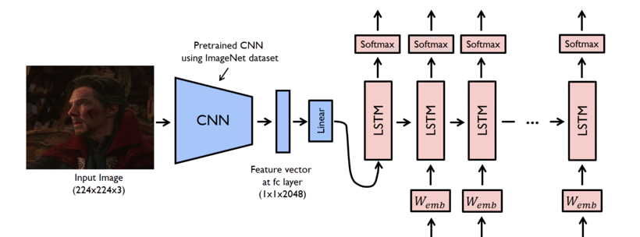
SOLUTION
We introduce a Bangla news dataset. Development of a Bangla contextual newspaper dataset consists of both news images embedded with news articles.
We focus on two seq2seq deep neural network architecture to address the Bangla news image caption generation. The first model is CNN-LSTM architecture and the other model is on the attention mechanism. CNN is working as an encoder to extract the image features. LSTM layer works as a decoder for decoding sentences to generate a vector representation of the image caption. The attention mechanism is used to decide where to put attention and what information to analyze.

Slide 6

Requirement analysis
We introduce a Bangla news dataset. Development of a Bangla contextual newspaper dataset consists of both news images embedded with news articles.
We focus on two seq2seq deep neural network architecture to address the Bangla news image caption generation.
CNN model working as an encoder to extract the image features.
LSTM layer works as a decoder for decoding sentences.
Attention mechanism is used to decide where to put attention and what information to analyze.

Slide 7

Impact on Society
News image captioning is the most common technique and the biggest challenge that is helpful for journalists for describing the news contents. Thus, news caption generation finds its applications in news, media and multimedia analysis.

Slide 8
Project Management
 | January |  |  | February |  |  |  | March |  |  |  | April
 | Week 01 | Week 02 | Week 03 | Week 01 | Week 02 | Week 03 | Week 04 | Week 01 | Week 02 | Week 03 | Week 04 | Week 01 | Week 02
Project Research
Specification
Planning
Design
Development
Training
Assessment
Documentation

Slide 9
Project Cost
Task | Duration(days)
Project Research | 10
Specification | 11
Planning | 9
Design | 12
Development | 14
Training | 14
Assessment | 8
Documentation | 13
Total | 91 (13 weeks)

Slide 10


